Slide 1
Analyzing the Impact of Workout Frequency and Session Duration on Calories Burned among Gym Members Course: CIS 2423 - Programming for Data Analytics
Group Members: Shahad Alzarooni H00502241, Meirah Alhantoobi, H00496472, Asmaa Aljaberi H00500852

Slide 2
Executive Summary:
This project analyzes the impact of workout frequency and session duration on calories burned among gym members using a gym dataset sourced from Kaggle. Through data cleaning, sampling, visualization, hypothesis testing, regression, classification, clustering, and version control, the study provides actionable insights into member behaviors. Python was selected for its strong data handling and machine learning libraries. Multiple machine learning models were built, optimized, and evaluated, leading to the identification of the best predictive models. GitHub was used for version control and team collaboration. Overall, this project successfully meets the course learning outcomes by applying professional data analytics and machine learning techniques.

Slide 3
Independent Variables: Workout_Frequency (days/week): The number of days per week a gym member works out. Session_Duration (hours): The average duration of each workout session. Dependent Variable: Calories_Burned: The total number of calories burned per session. This is the target variable we aim to predict based on the workout behavior.
Variable Selection

Slide 4
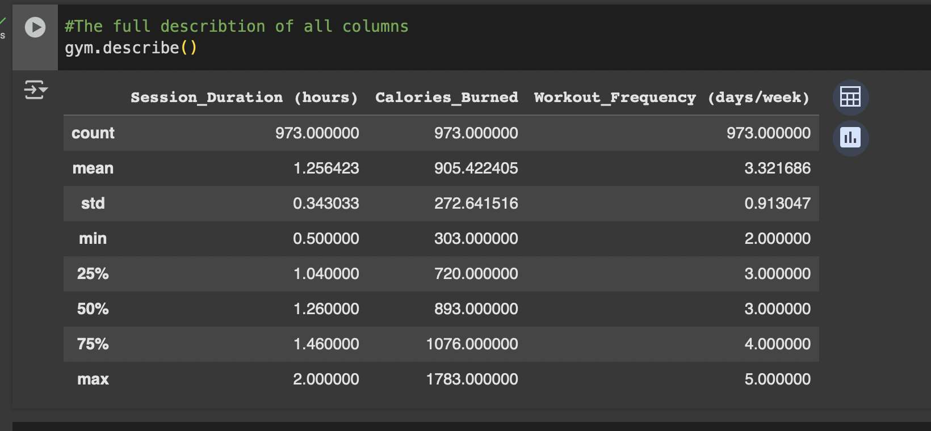
Descriptive Statistics & Sampling

Slide 5
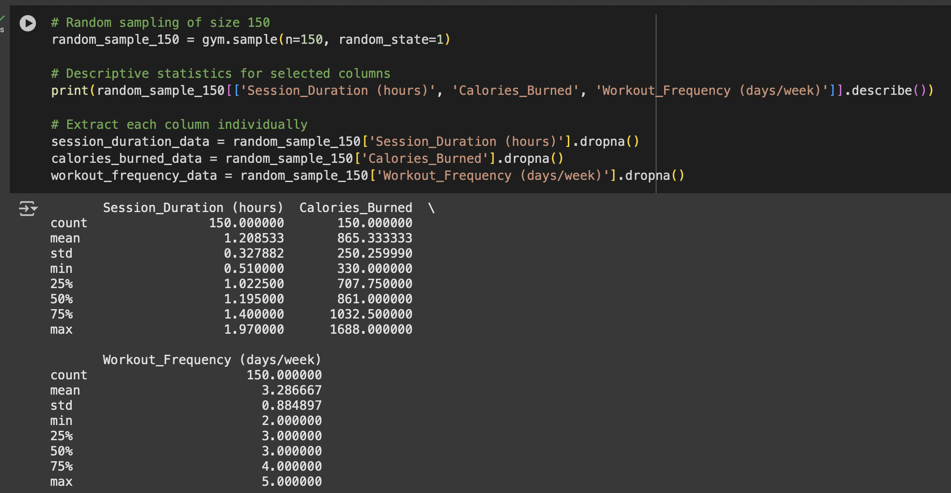
Descriptive Statistics & Sampling

Slide 6
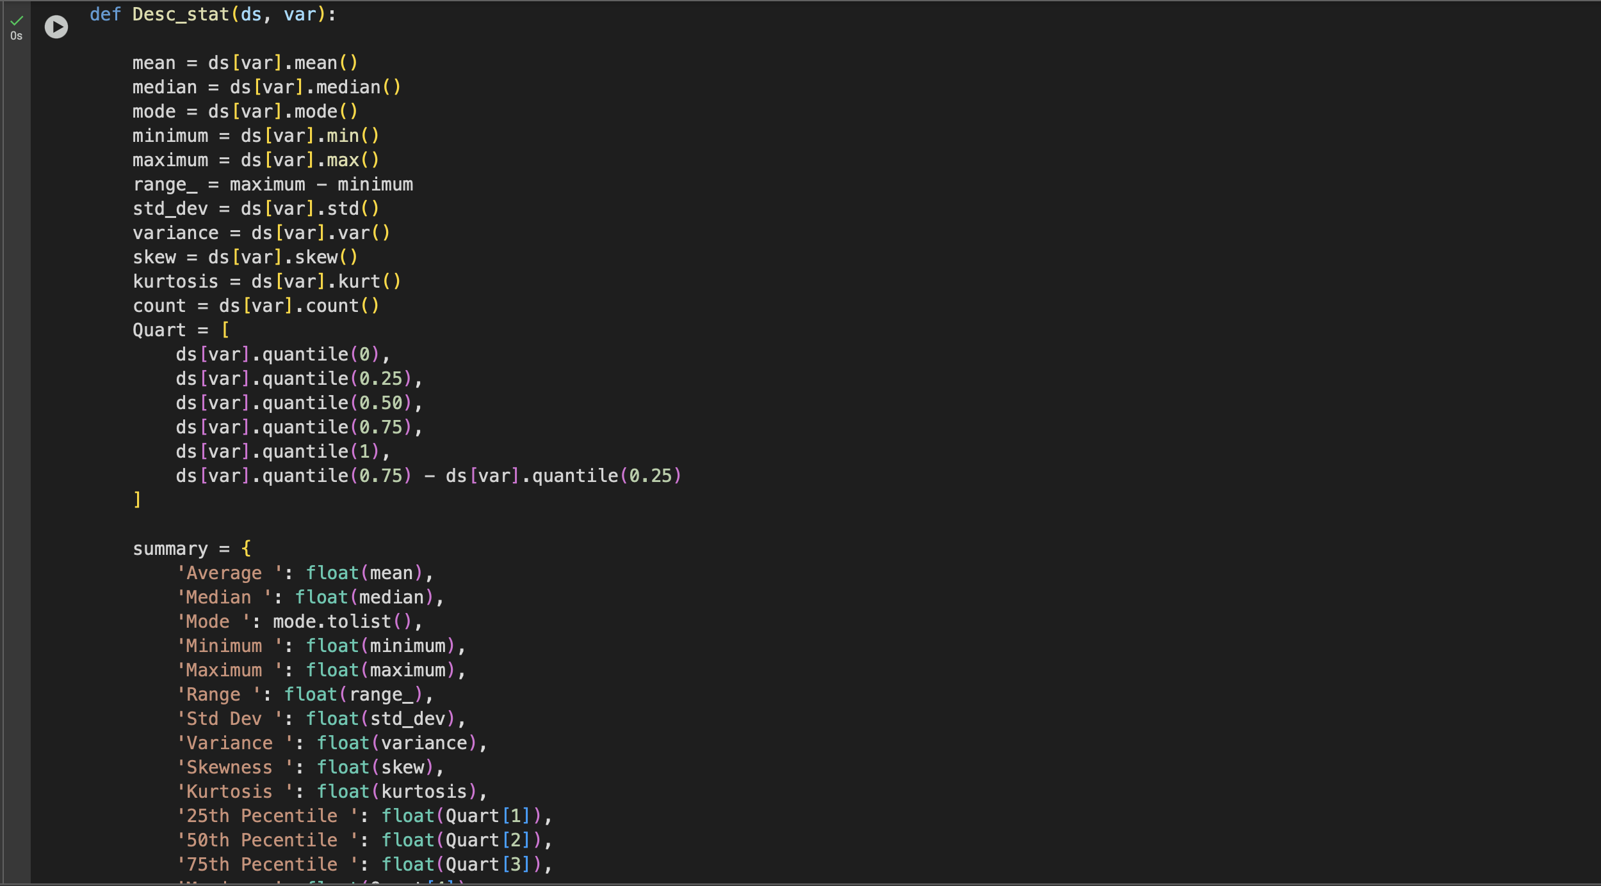
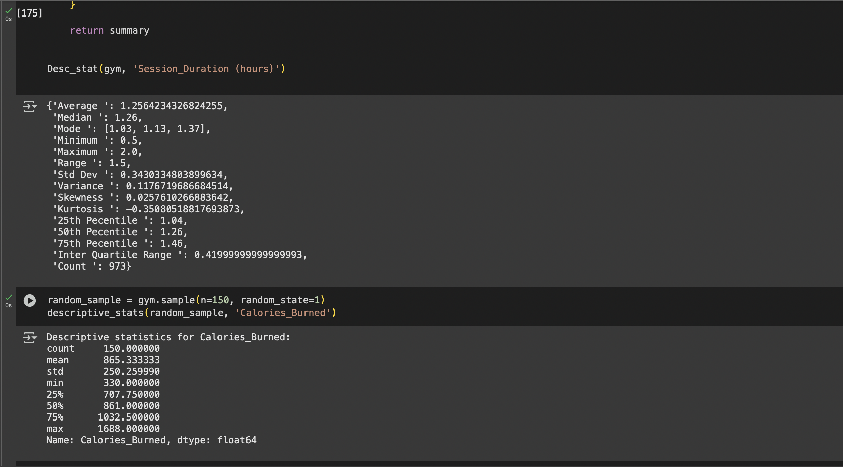
Descriptive Statistics & Sampling

Slide 7
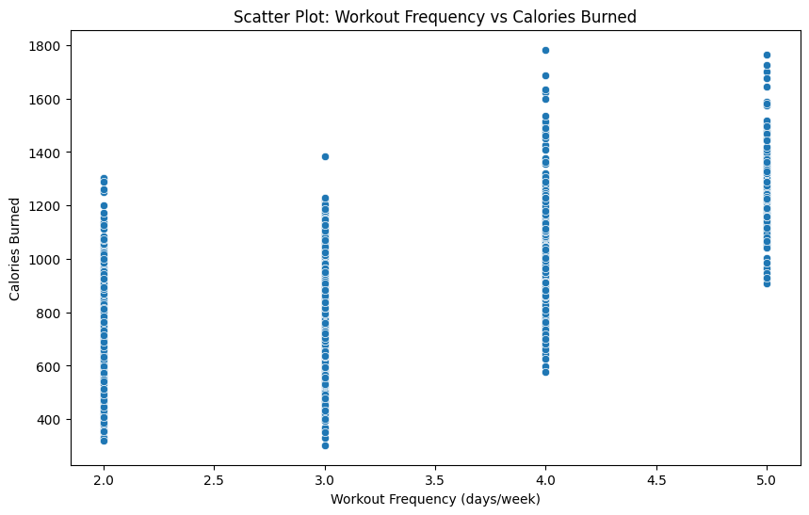
Data Visualization
Scatter Plot: Displayed the linear relationship between Workout Frequency and Calories Burned.

Slide 8
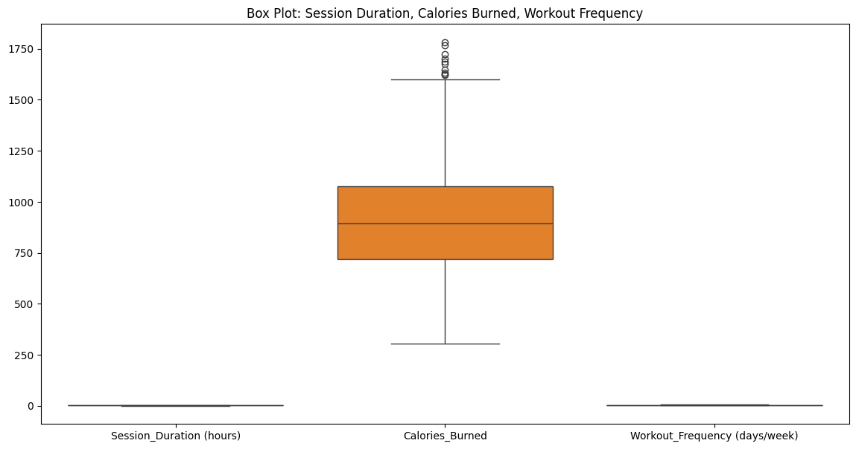
Box Plot:
Showed the distribution and outliers in the main variables.

Slide 9
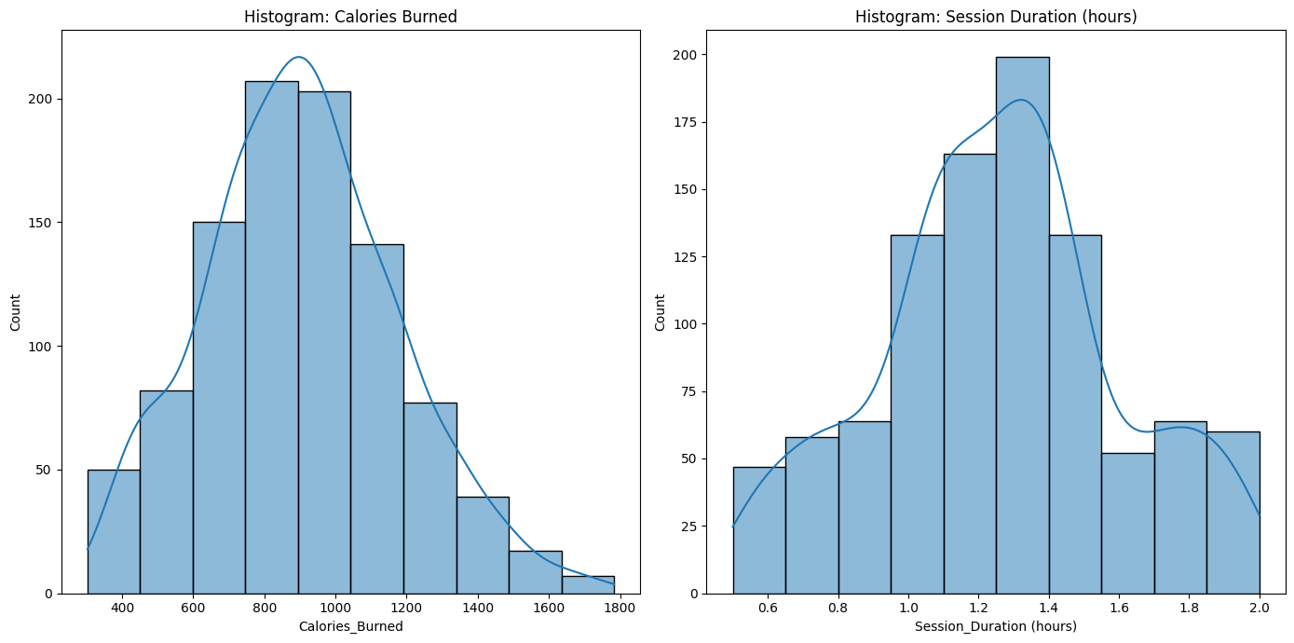
Histograms:
Provided insights into the distribution patterns of Session Duration and Calories Burned.

Slide 10
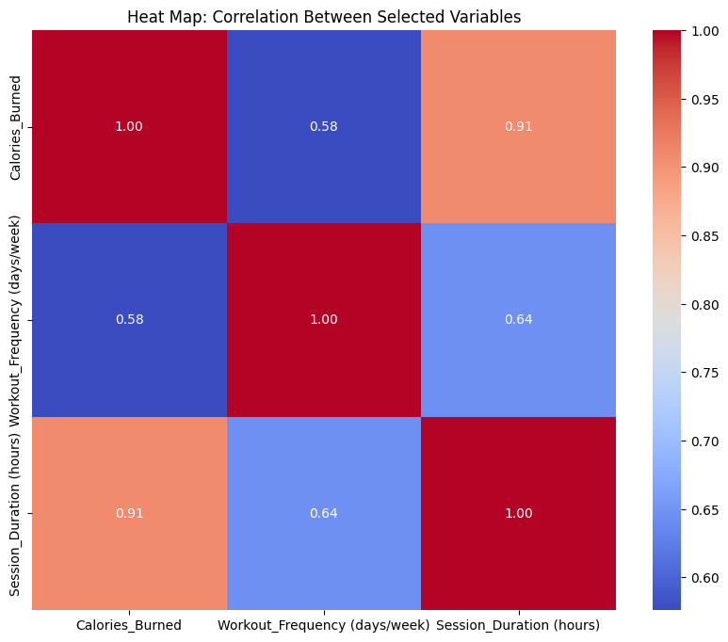
Heat Map:
Presented a correlation matrix, identifying relationships between variables.

Slide 11
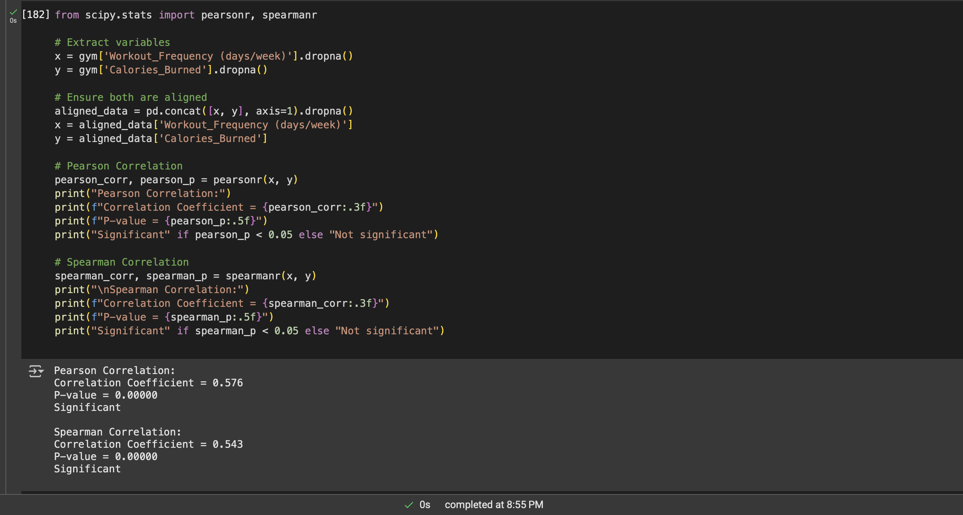
Hypothesis Testing

Slide 12
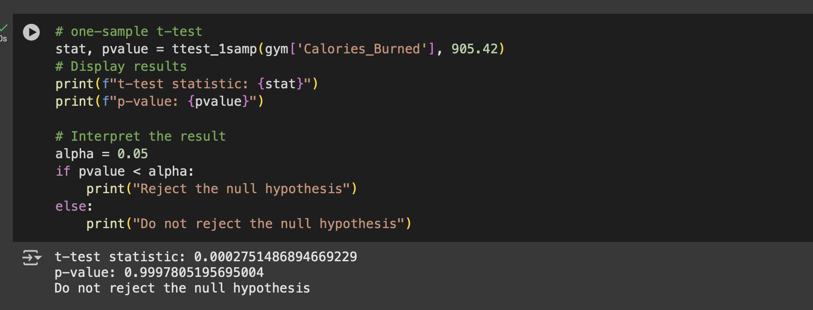
T-Test

Slide 13
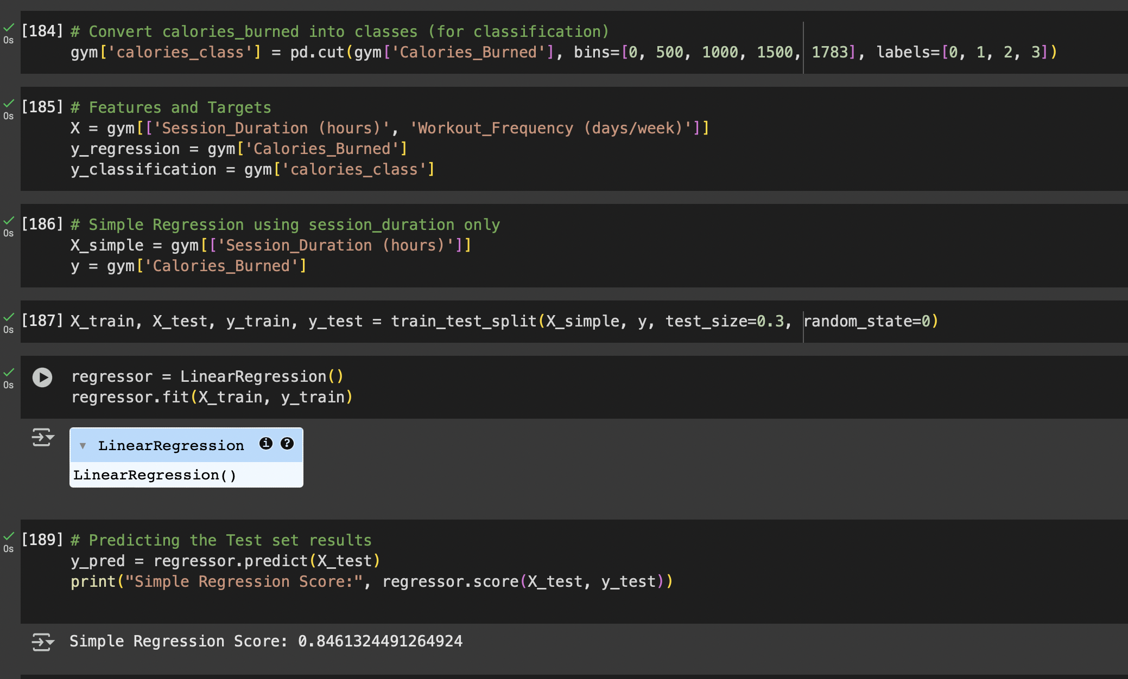
Regression Analysis

Slide 14
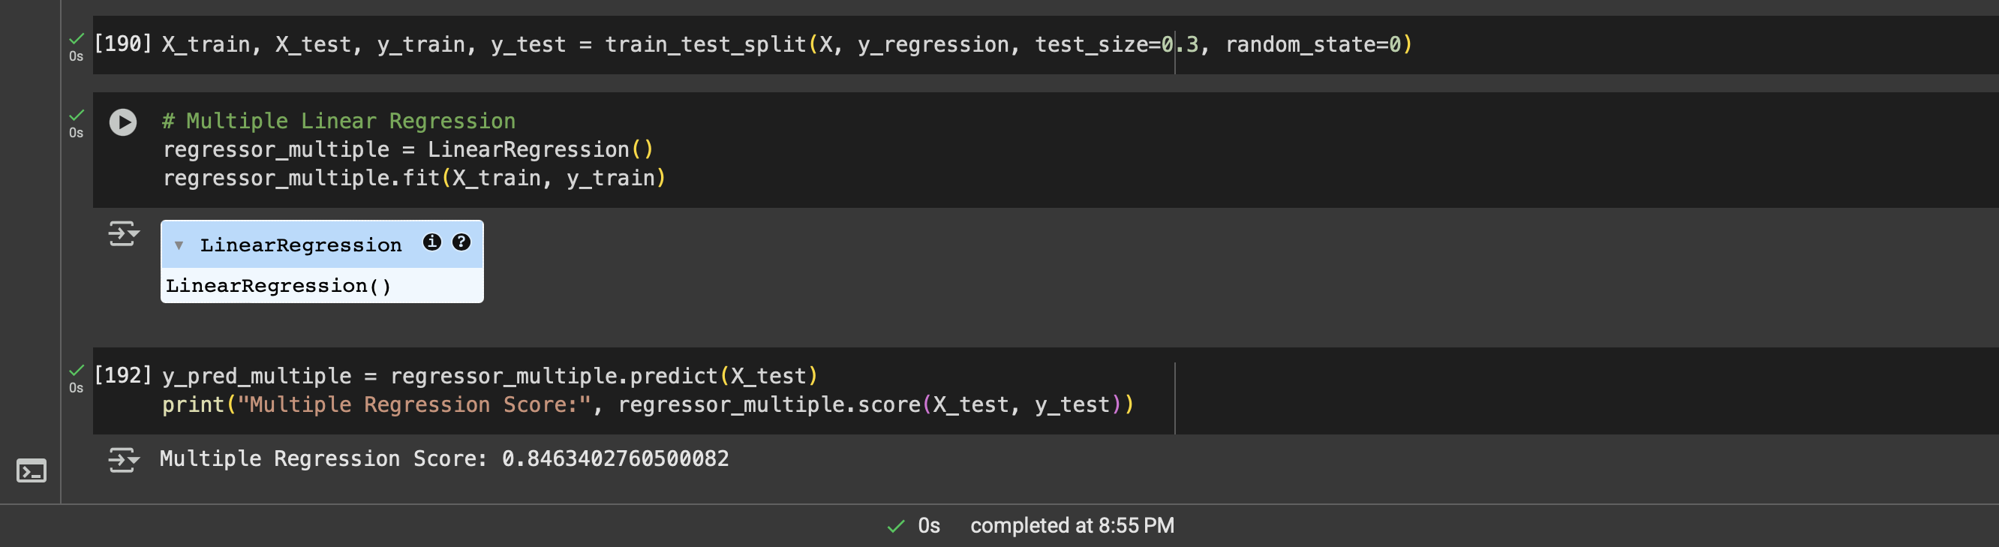
Multiple Linear Regression

Slide 15
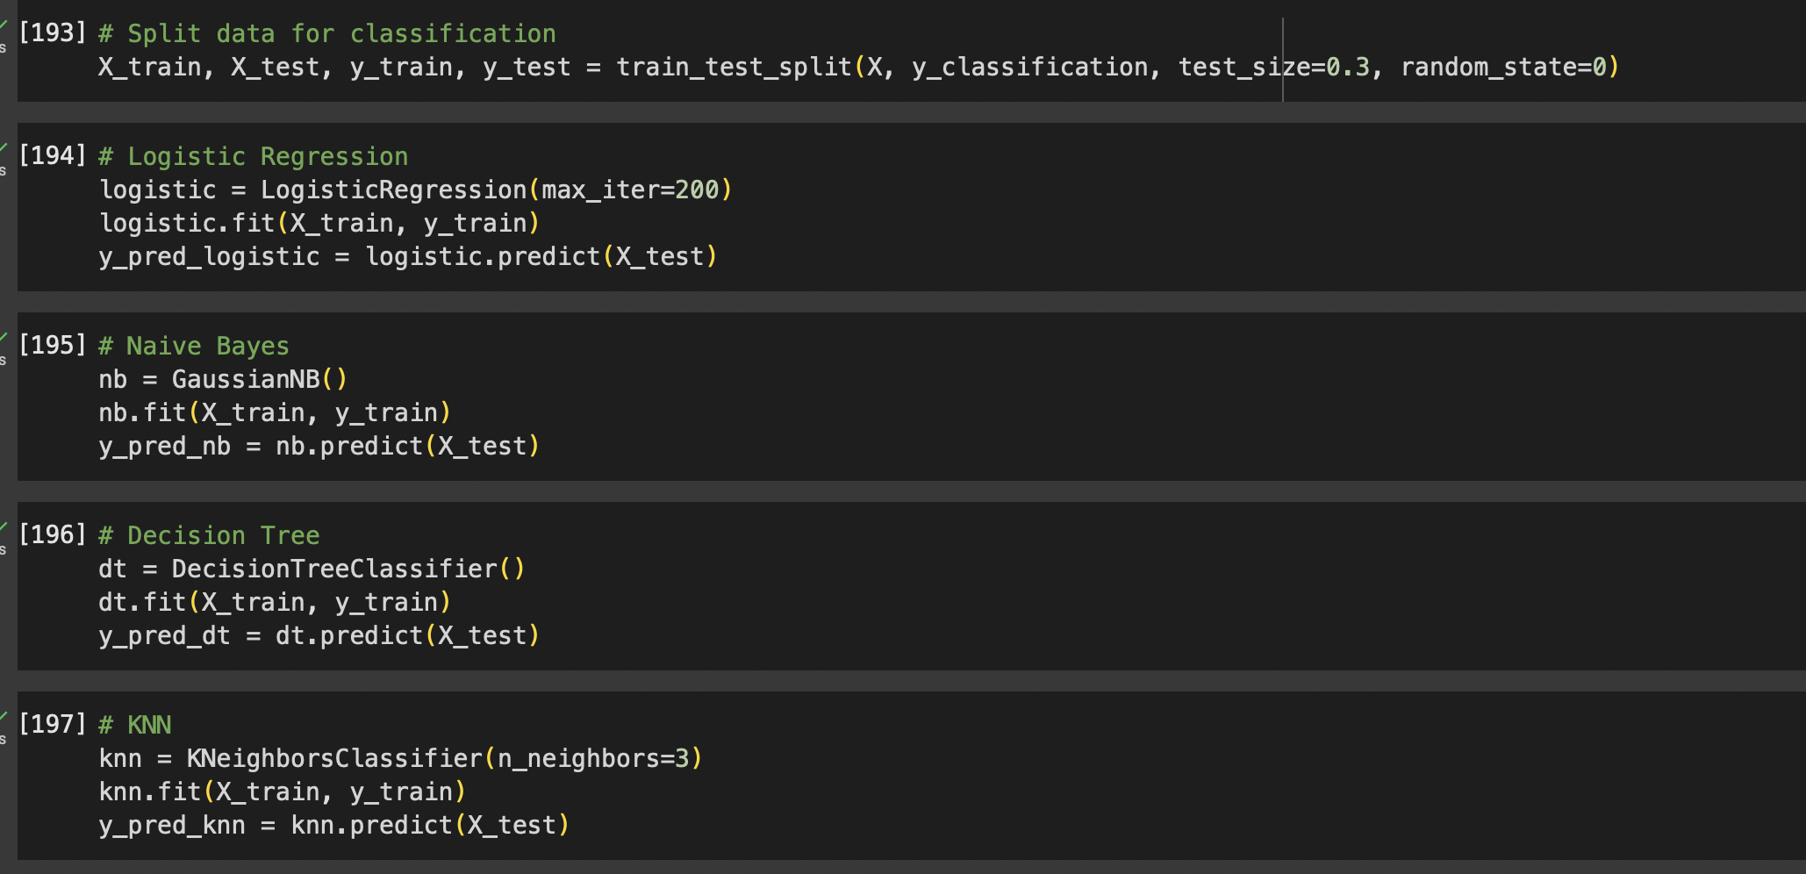
Classification Models

Slide 16
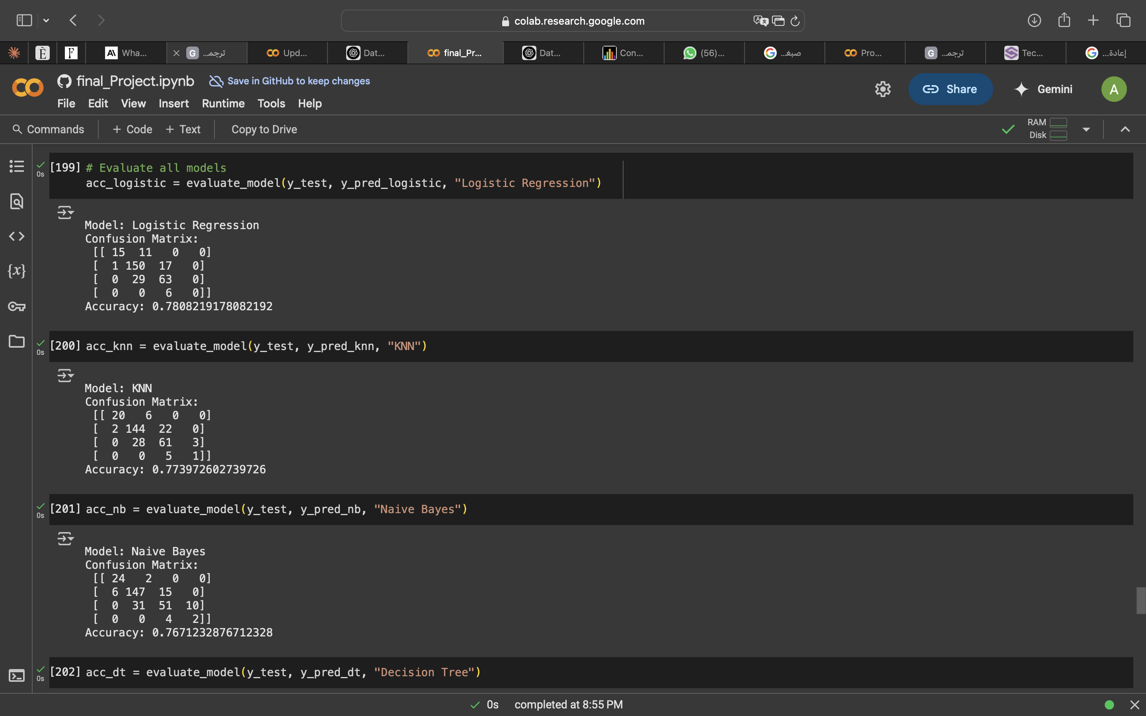
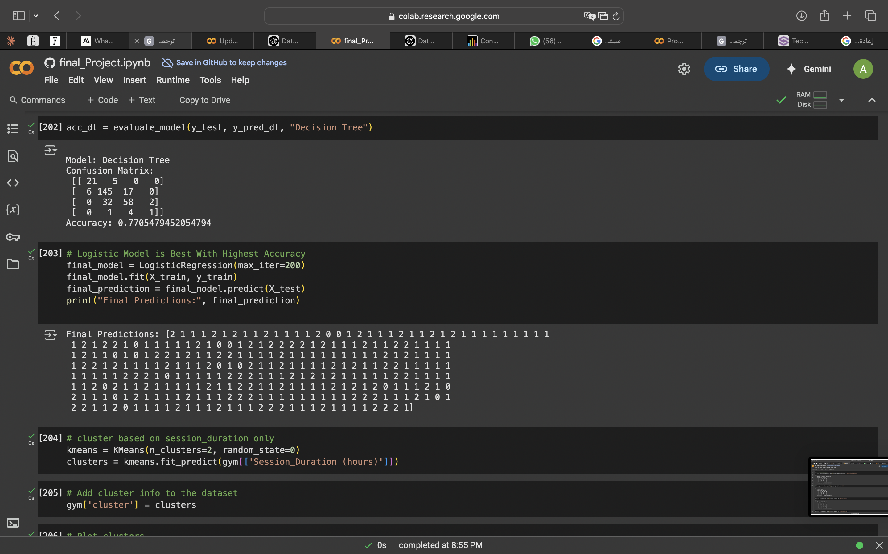
Model Evaluation

Slide 17
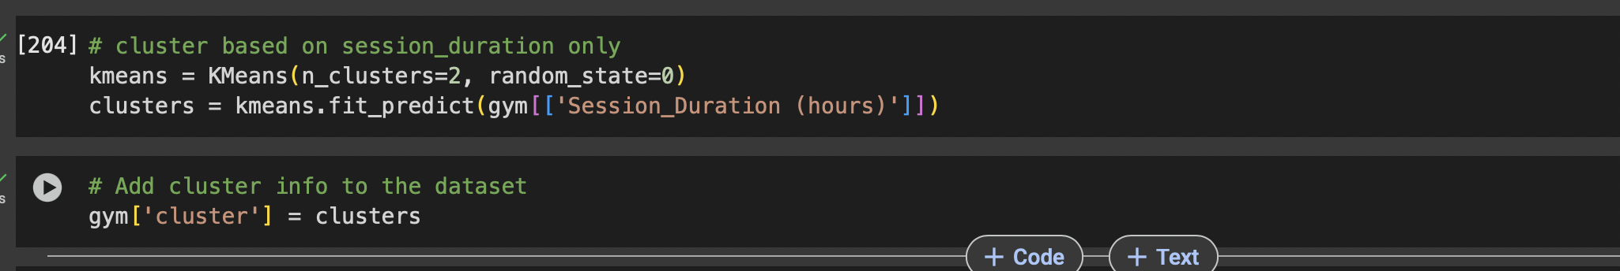
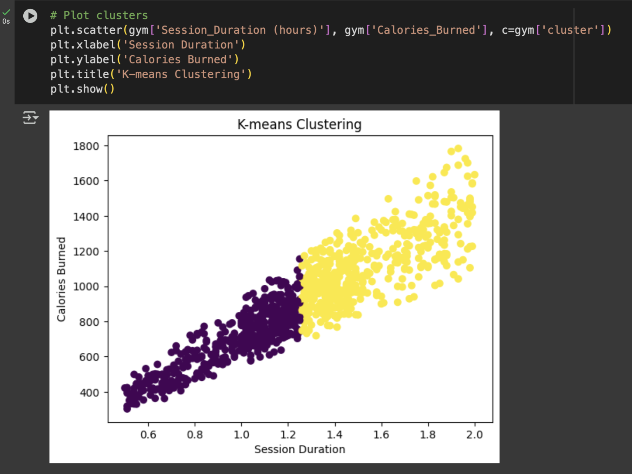
Clustering Analysis
The cluster diagram shows that longer session times lead to more calories burned. This indicates distinct user groups, such as casual and serious users.
Creating separate models for each group could improve predictions. Adding cluster labels may reveal hidden patterns, and addressing outliers can help accuracy. Clustering can enhance recommendations and predictions.

